Slide 1
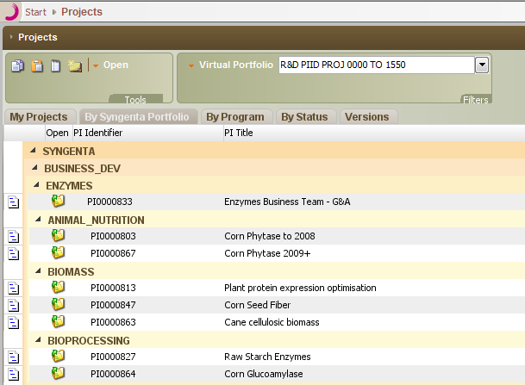
1. Export Data from Smart Choice into Excel
Exported Data from Smart Choice
Smart Choice Exports from the Projects View and the Activities Scheduling / Gant View (about 100 Sheets) into Excel
Macros in MS Word or MS Access

Slide 2
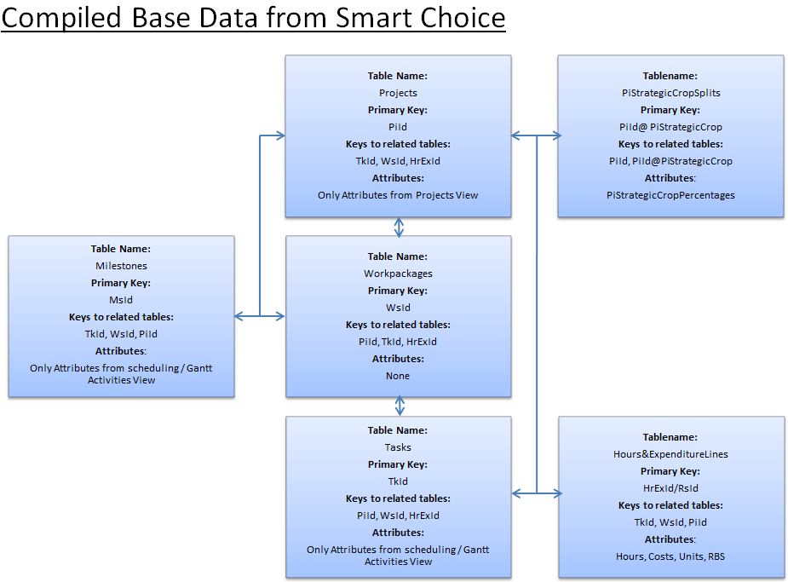
2.1 Generation of Base DataStructure in Excel
Generation of Base DataStructure
Take as input the Smart Choice Exports from the Projects View and the Activities Scheduling / Gant View (about 100 Sheets) in Excel
Macros in MS Excel or MS Access

Slide 3
2.2 Compiled Base Data from Smart Choice
Table Name:
Projects
Primary Key:
PiId
Keys to related tables:
TkId, WsId, HrExId
Attributes:
Only Attributes from Projects View
Tablename:
PiStrategicCropSplits
Primary Key:
PiId@ PiStrategicCrop
Keys to related tables:
PiId, PiId@PiStrategicCrop
Attributes:
PiStrategicCropPercentages
Table Name:
Milestones
Primary Key:
MsId
Keys to related tables:
TkId, WsId, PiId
Attributes:
Only Attributes from scheduling / Gantt Activities View
Table Name:
Workpackages
Primary Key:
WsId
Keys to related tables:
PiId, TkId, HrExId
Attributes:
None
Table Name:
Tasks
Primary Key:
TkId
Keys to related tables:
PiId, WsId, HrExId
Attributes:
Only Attributes from scheduling / Gantt Activities View
Tablename:
Hours&ExpenditureLines
Primary Key:
HrExId/RsId
Keys to related tables:
TkId, WsId, PiId
Attributes:
Hours, Costs, Units, RBS

Slide 4
3. Data Migration from Excel to Access
Generation of Base DataStructure
Data cleansing. Remove all «Tabs» and «Page Breaks» from the Excel tables
Store the Excel tables as Tab-Delimited Text File (.txt)
Migrate the Tab-Delimited Text Files into Access
Macros in MS Access

Slide 5
4.1 Additional Tables for Offline Customization
Tablename:
Hours&ExpenditureLines
Primary Key:
HrExId/RsId
Keys to related tables:
TkId, WsId, PiId
Attributes:
Hours, Costs, Units, RBS
Tablename:
PiStrategicCropSplits
Primary Key:
PiId@ PiStrategicCrop
Keys to related tables:
PiId, PiId@PiStrategicCrop
Attributes:
PiStrategicCropPercentages
Tablename:
Hours&ExpenditureLines SpitByPiStrategicCrop
Primary Key:
HrExId/RsId@PiStrategicCrop
Keys to related tables:
TkId, WsId, PiId
Attributes:
Hours, Costs, Units, RBS
Macros in MS Access
Table Name:
Projects
Primary Key:
PiId
Keys to related tables:
TkId, WsId, HrExId
Attributes:
Only Attributes from Projects View
Table Name:
RDPortfolioReportingStructure
Primary Key:
PiId
Keys to related tables:
PiId
Attributes:
Technology, InnovationLifeCycle, InvestmentSegment
Macros in MS Access
Tablename:
PiStrategicCropSplits
Primary Key:
PiId@ PiStrategicCrop
Keys to related tables:
PiId, PiId@PiStrategicCrop
Attributes:
PiStrategicCropPercentages
Table Name:
BuildingBlocks&StrategicPillars
Primary Key:
PiId@PiStrategicCrop
Keys to related tables:
PiId@PiStrategicCrop
Attributes:
Building Block, Strategic Pillar
Porfolio Managers

Slide 6
4.2 Extended Data Structure in Access
Table Name:
RDPortfolioReportingStructure
Primary Key:
PiId
Keys to related tables:
PiId
Attributes:
Technology, InnovationLifeCycle, InvestmentSegment
Table Name:
Projects
Primary Key:
PiId
Keys to related tables:
TkId, WsId, HrExId
Attributes:
Only Attributes from Projects View
Tablename:
PiStrategicCropSplits
Primary Key:
PiId@ PiStrategicCrop
Keys to related tables:
PiId, PiId@PiStrategicCrop
Attributes:
PiStrategicCropPercentages
Table Name:
Milestones
Primary Key:
MsId
Keys to related tables:
TkId, WsId, PiId
Attributes:
Only Attributes from scheduling / Gantt Activities View
Table Name:
Workpackages
Primary Key:
WsId
Keys to related tables:
PiId, TkId, HrExId
Attributes:
None
Table Name:
BuildingBlocks&StrategicPillars
Primary Key:
PiId@PiStrategicCrop
Keys to related tables:
PiId@PiStrategicCrop
Attributes:
Building Block, Strategic Pillar
Table Name:
Tasks
Primary Key:
TkId
Keys to related tables:
PiId, WsId, HrExId
Attributes:
Only Attributes from scheduling / Gantt Activities View
Tablename:
Hours&ExpenditureLines SpitByPiStrategicCrop
Primary Key:
HrExId/RsId@PiStrategicCrop
Keys to related tables:
TkId, WsId, PiId
Attributes:
Hours, Costs, Units, RBS

Slide 7
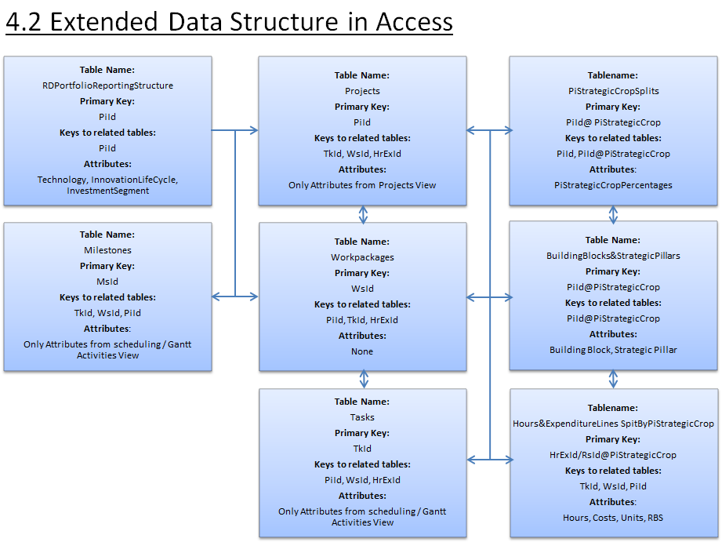
5. Customized DataSets/Reports
Customized DataSets/Reports
Functional Reporting
Portfolio Reporting
Milestone Reporting
Data Quality Tool Input
Other Customized Reports
SQL Queries and Macros in MS Access

Slide 8
6. Change Requests for Quarterly Reports
Template tables where requested change requests are entered
Change Requests for Quarterly Reports
Update- Queries or Macros in MS Access

